Slide 1
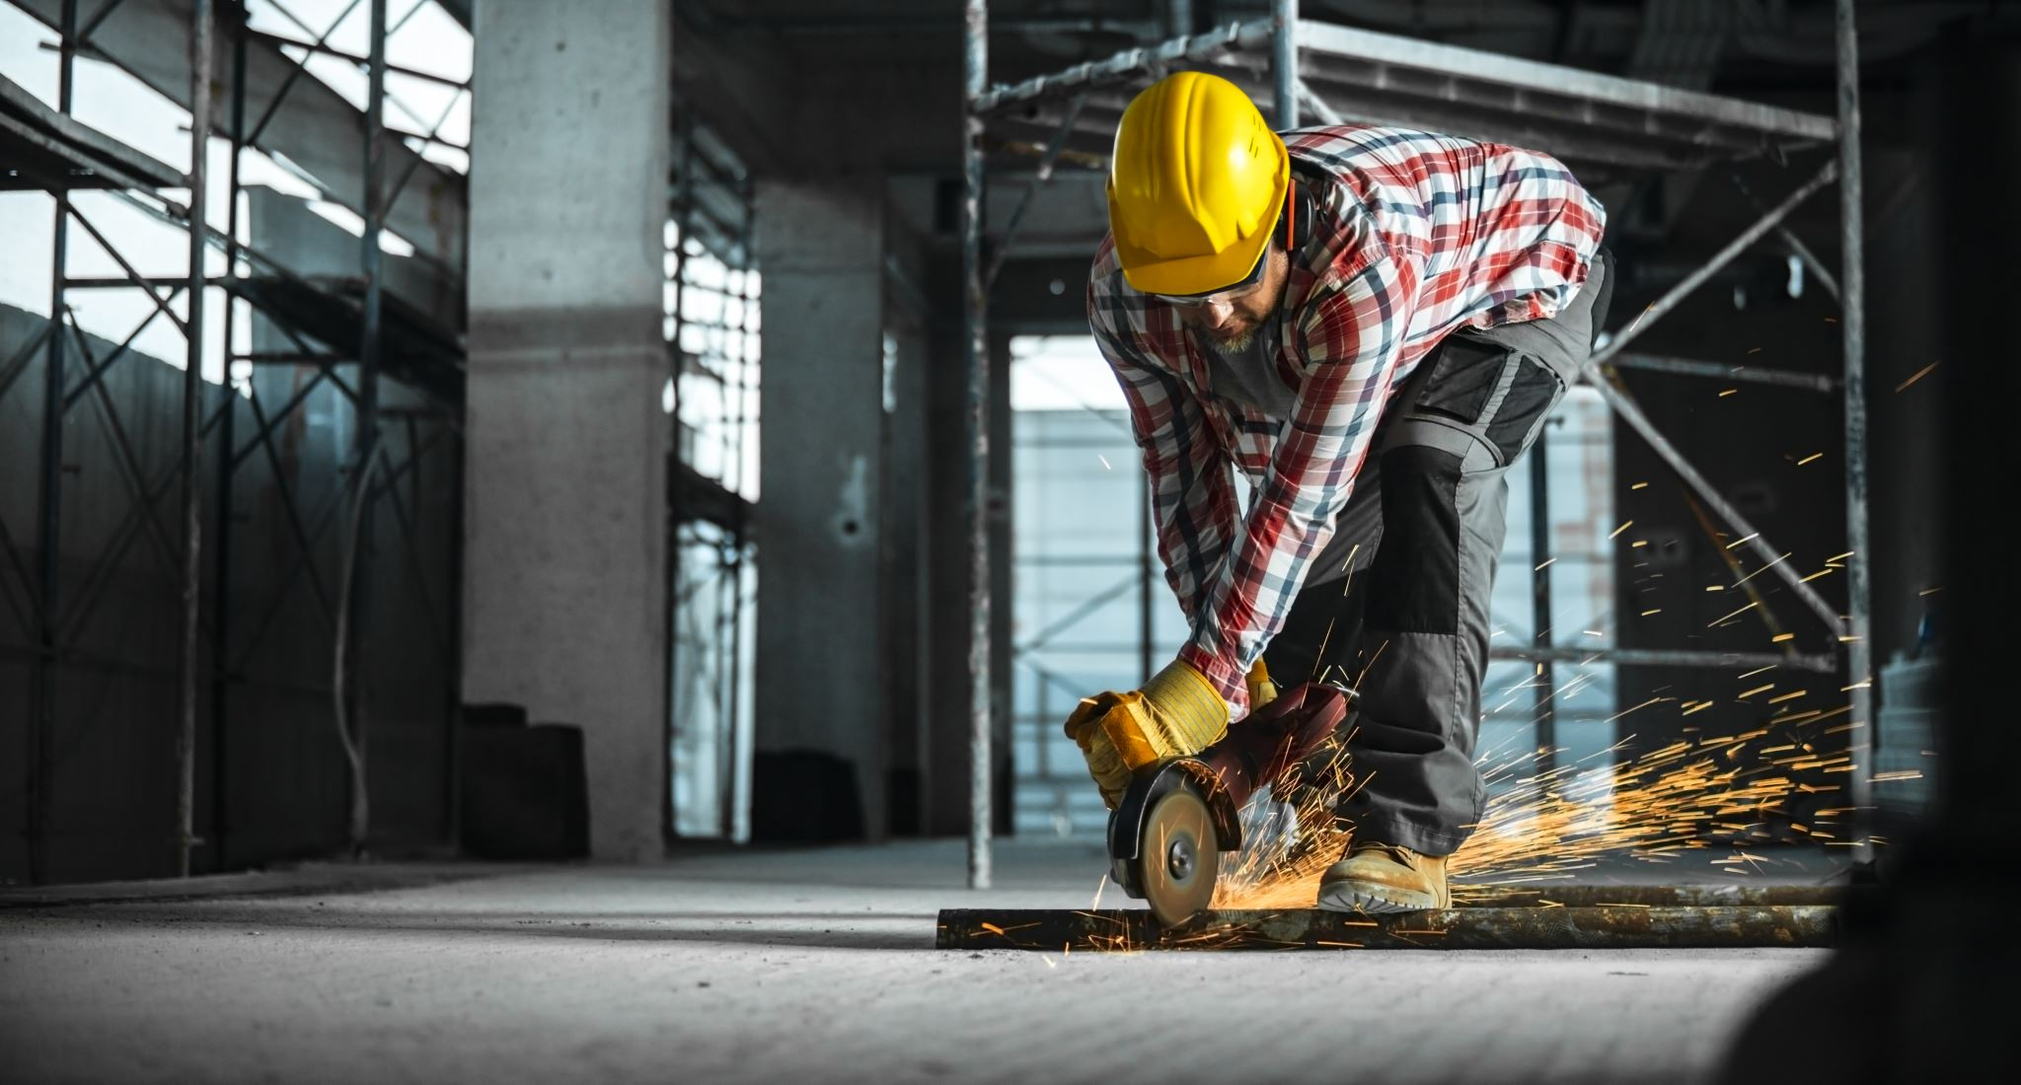
02-2/ LU3: ON-SITE WOOD CONSTRUCTION ASSEMLING MANAGEMENT
ERGONOMICS AND LABOR SAFETY

Slide 2
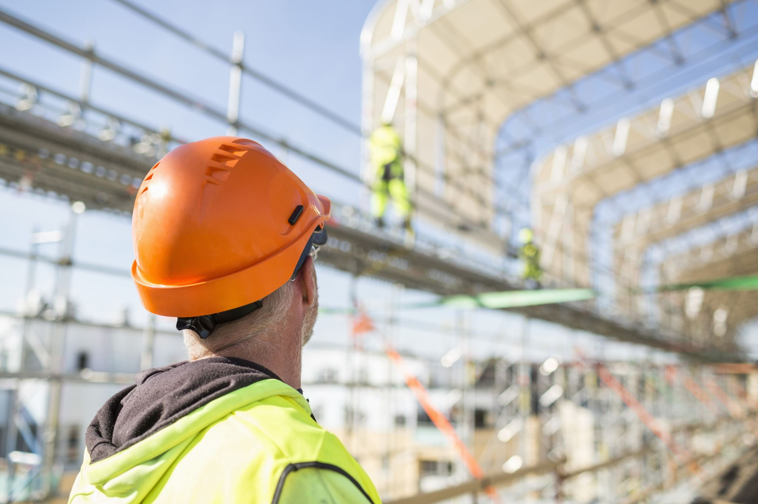
PRESENTATION OVERVIEW
Topics covered
Legislation
Ergonomics
Risks
Safety as a common thing
Benefits
Frequently asked questions

Slide 3
In the European Union, occupational safety is regulated by a directive.
The directive is part of national law and an act adopted under the Treaty on European Union is binding in its entirety.
An EU Member State may have national laws on occupational safety, which must therefore be in line with the EU directive.
A Member State may issue regulations of the President of the Republic or the Council of State.
In addition, a Member State may take a decision specifying a law or regulation..
Legislation
3

Slide 4
The goal of ergonomics is to develop the way work is done in such a way that it is as suitable as possible for each person in terms of the number of repetitions and strength needs, and that the work position and work environment would support work performance.
The power requirement of the work can be regulated by means of ergonomics.
To increase ergonomics, technical aids such as machines and equipment can be used at work.
Ergonomics
4

Slide 5
Risks
Risks due to working conditions:
Dust, mold spores, bacteria, VOCs and gases
Noise, vibration, heat, cold and tonnage
Lighting, glare, fog or exhaust fumes
Exposures, toxins, gases and solvents
Risks related to the work environment:
Internal and external traffic on the site
Use of implements and tools
Storage and handling of waste and hazardous substances
External actors (e.g., residents, curious, etc.)
Use of workspaces during work and moving machine parts
Risks arising from work planning and management:
Site schedule and timing of work phases
Simultaneous work
Inconsistent management and quality degradation
Risks related to doing the work:
Purchases and transfers of materials and personnel
Scaffolding and support work
Installation of elements and molds
Demolition and excavation work
Electrical work
Fire work
Work on the road or track area
Asbestos work
Work near an industrial process line

Slide 6
Common construction site
0-accident thinking
Security observation
Harness work
Protective equipment
Lifting aids
Induction
Work guidance
Safety as a common thing
6

Slide 7
Benefits
PRODUCTIVITY
WELL-BEING AT WORK
Absenteeism is reduced, coping at work is improving and older workers can stay in work longer.
In a safe work environment, job satisfaction improves and accident risks are reduced.
COPING
COSTS
Ergonomic workstations and working positions make work easier, even faster and reduce stress injuries.
Productivity improves as sick leave is reduced and at the same time health care costs are reduced.

