Slide 1
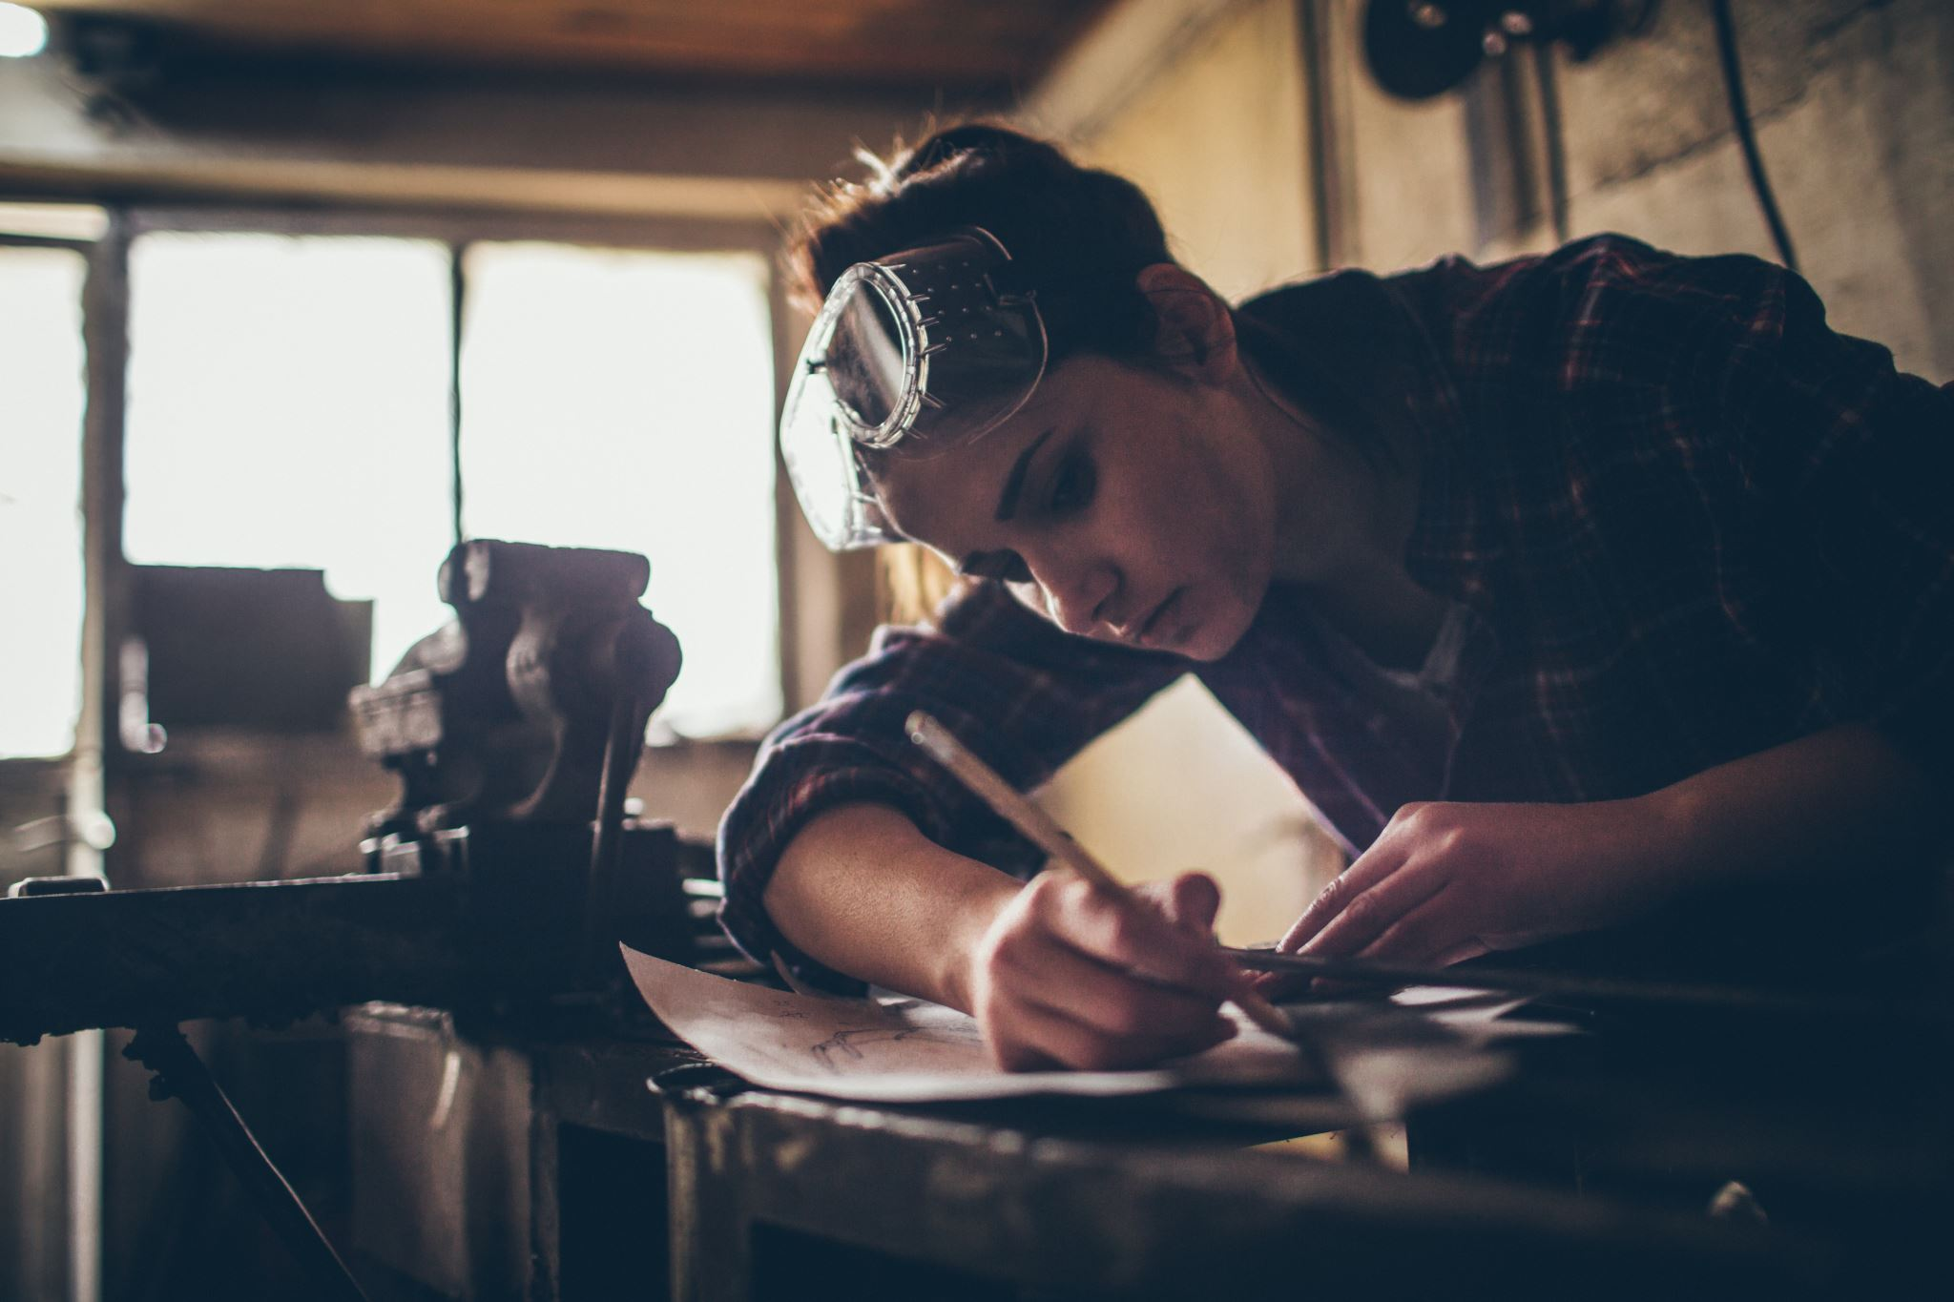
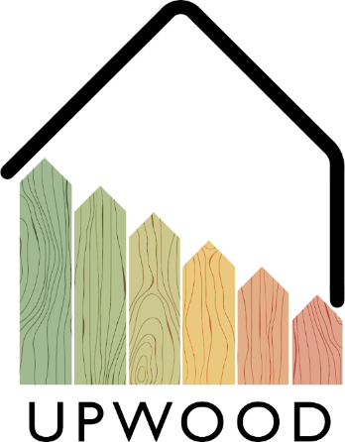
02-5/ LU2: TIMBER CONSTRUCTION, RENOVATION AND DECONSTRUCTION
CONNECTORS AND ADHESIVES

Slide 2
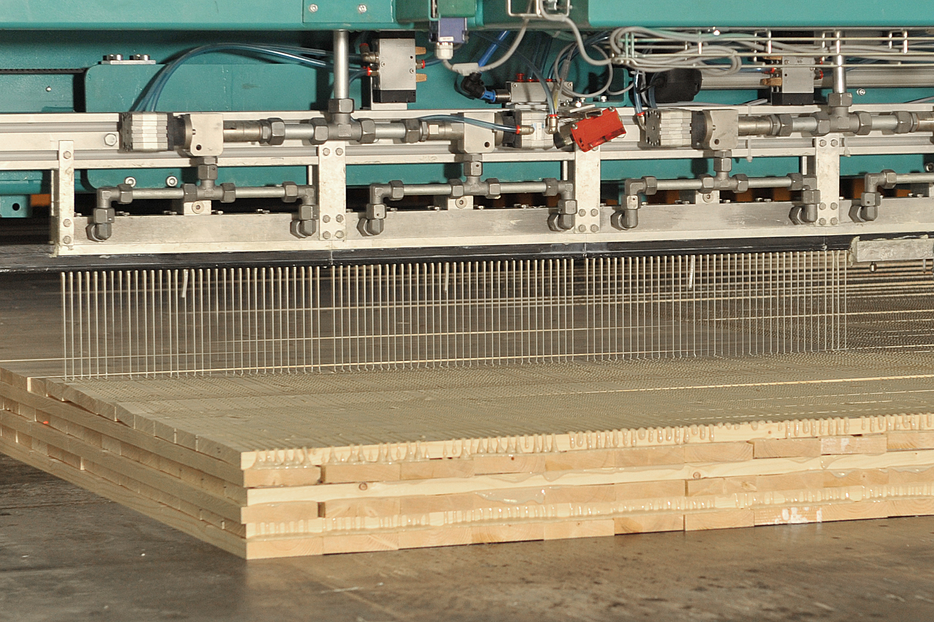
PRESENTATION OVERVIEW
Topics covered
Screw fastening
Adhesives
Different adhesives
Use of connectors and adhesives
Frequently asked questions

Slide 3
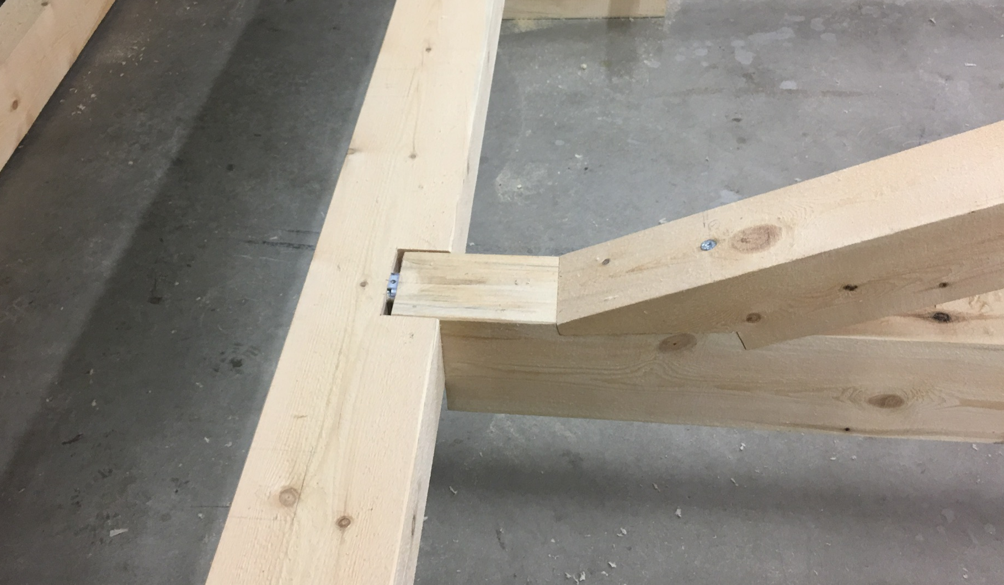
Screw fastening
For screw fastenings
First find out:
What building material do you attach to?
What conditions should the installation withstand?
What kind of load is applied to the installation?
Do the installation work carefully:
Drill the correct size drill hole.
Clean the borehole with a brush and air.
Observe the specified installation depths.
Tighten the installation carefully.
Use only CE-marked fastening products.
Wear protective equipment.
3

Slide 4
Wood is rarely made into an object that would be a single piece of wood because wood lives according to moisture and is not as strong in all directions, which is why wooden objects are always assembled from several pieces with joints.
Adhesive joints are affected by the quality of the adhesives, the surfaces to be bonded and the adhesive surface area.
Wood welding is a method that replaces gluing. In it, two pieces of wood are rubbed together very vigorously for a while, causing them to heat up due to friction. As a result, the ends of the cellulosic fibers open and are able to adhere to similar cellulosic fibers of the mating piece.
Deciduous trees form a bond that corresponds in strength to gluing, but the bond does not withstand moisture. In conifers, such a joint is weak.
Adhesives
4

Slide 5
When choosing the adhesive, the conditions under which the finished adhesive joint is exposed must be taken into account.
Roughly, adhesives can be divided into three groups according to durability:
Weatherproof adhesives - adhesives must be more durable than wood in all conditions. The seam must be able to withstand weather conditions, cooking and microorganisms. These requirements are met by phenolic and resorcinol adhesives and their mixtures.
Moisture-resistant adhesives - adhesives are suitable for indoor use where the relative humidity may be quite high. This group includes melamine adhesives, as well as some urea adhesives and PVAc adhesives.
Adhesives suitable for indoor use - adhesives do not withstand water soaking and last for a limited time in humid rooms. The most widely used wood adhesives, urea and PVAc adhesives belong to this group.
Different adhesives
5

Slide 6
Use of connectors and adhesives
PRODUCTIVITY
EFFICIENCY
Choosing the right glue or connector shortens production time and improves the functionality of the production process.
Proper use of the fastener and the right fastening means improve work efficiency and reduce material loss.
ENVIRONMENT
COSTS
Properly selected bracket materials withstand even difficult conditions.
The price of the glue or fastener may be higher at the time of purchase for structures required for difficult conditions, but better durability results in a longer service life.

