Slide 1
Up-skilling construction workers in wood construction methods for energy efficient buildings
Upwood Project
2nd Dissemination Campaign

Slide 2
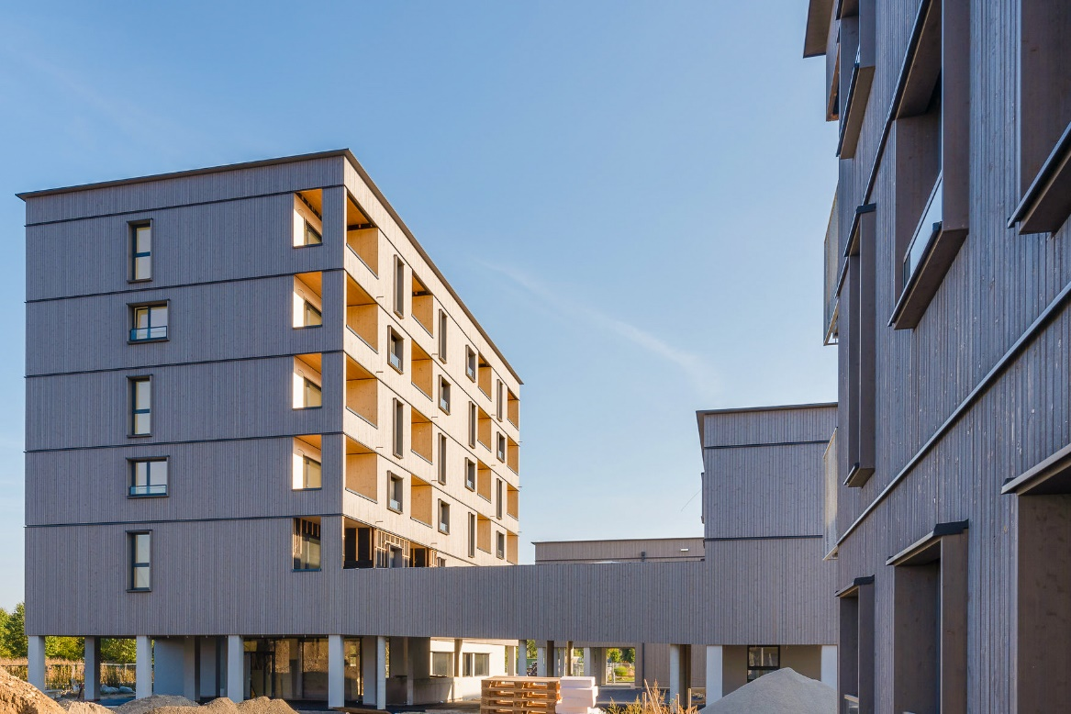
Project aim
UPWOOD forms a Strategic Partnership improve work-based learning VET, by developing and making available educational resources to address current and emerging occupational skills needs for energy efficient and innovative woodworking construction practices.
Project duration: October 2019 - March 2022
Duration: 30 months
©Pierer/WOHNBAUGRUPPE ENNSTAL

Slide 3
OBJECTIVES
Develop new training content on energy efficient wood construction methods and applications.
Develop teaching materials, VET integration guidelines, and trainer’s guide to support VET providers to integrate new woodworking technologies and processes into their WBL and apprenticeships offerings.
Improve cooperation between VET providers and businesses to provide opportunities that will enable learners to apply the acquired knowledge and skills in real-life workplace situations.
1
2
3

Slide 4
MAIN TARGET GROUPS
Construction sector employers
VET & WBL Apprentices in construction sector
Sector representatives and policy makers
VET & WBL providers
Associations, Networks & Social partners
VET authorities & career guidance bodies

Slide 5
MAIN OUTPUTS (1/2)
O1 UPWOOD work-based learning outcomes
Analysis of current and future skills and knowledge needs leading to the development of learning outcomes.
O2 UPWOOD learning units and Open Educational Resources
Development of the structure of a curriculum on innovative, energy efficient woodworking technologies, methods, and practical applications.
Creation of corresponding pedagogical materials to be offered as Open Education Resources.

Slide 6
MAIN OUTPUTS (2/2)
O3 Online training scenarios
Development, testing, and delivery of Online Training Scenarios on woodworking in construction, promoting the uptake of innovative and flexible practices in VET.
O4 Framework for the integration of environmental components into construction sector WBL curricula and certification schemes
Involvement of key policy makers & stakeholders for the recognition of UPWOOD learning outcomes as well for supporting the integration of construction woodworking skills into occupational standards.

Slide 7
2nd PROJECT MEETING
The second meeting of the project was foreseen to be held by the UPV, in Valencia, but due to the situation caused by the COVID-19 it had to be held online on 20th of May 2020.
The partners addressed the intellectual outputs O1 and O2 and focused mainly on the task O2-T1 “Clustering of learning outcomes into learning units”, which has been further improved with the opinions of all partners.
All the tasks to be carried out were reviewed and the next meeting was planned. Despite the enthusiasm of the members to meet in Liepaja (Latvia), it should be held online.
UPWOOD 2nd project meeting (Virtual)
20 May 2020

Slide 8
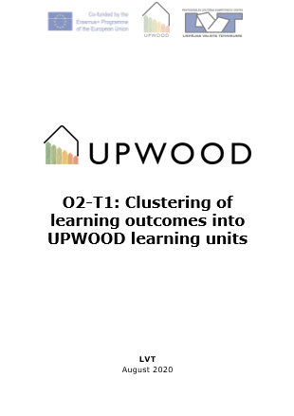
ACTIVITY PROGRESS
O2-T1 Fine-tuning of learning units
During these last months of the project, the partners have been identifying the learning units for UPWOOD Open Education Resources. The learning outcomes based on the findings of the research and survey carried in frame of the Intellectual output 1 during the first semester, have been group into learning units that collect the set of skills, knowledge and competencies required and identified by construction sector.
Learning units have been created following the criteria set up by the European ECVET network and it has been specified each one: the title, the list of topics of the learning unit content, learning objectives, prerequisites, amount of learning materials (lecture notes, presentations, case studies, FAQs), planned duration of the learning unit and references.

Slide 9
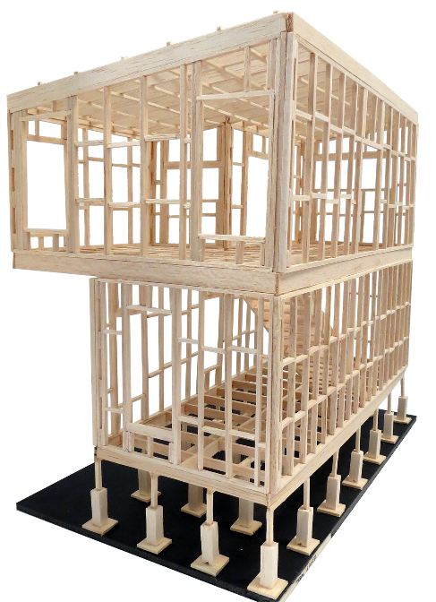
ACTIVITY PROGRESS
O2-T1 Fine-tuning of learning units
LU1: Qualities of wood and its various applications in construction
Wood properties (physical-mechanical, technological, operational, etc.), its limitations and wood construction physics.
LU2: Timber construction, renovation and deconstruction
Performance and durability of wooden structures.
Possibilities of improving the properties of the wood and wood protection, durability.
Availability and environmental friendliness of wood as a building material.
Guidelines on work with sawn materials, wood-based panel and engineered wood products (EWP).
Guidelines on work with Glued Laminated Timber (GLT) and Cross Laminated Timber (CLT).
Guidelines on work with different construction products (windows, doors, etc.).
Use of connectors and adhesives.
Restoration, reconstruction and dismantling of wooden elements.
Wooden trusses.

Slide 10
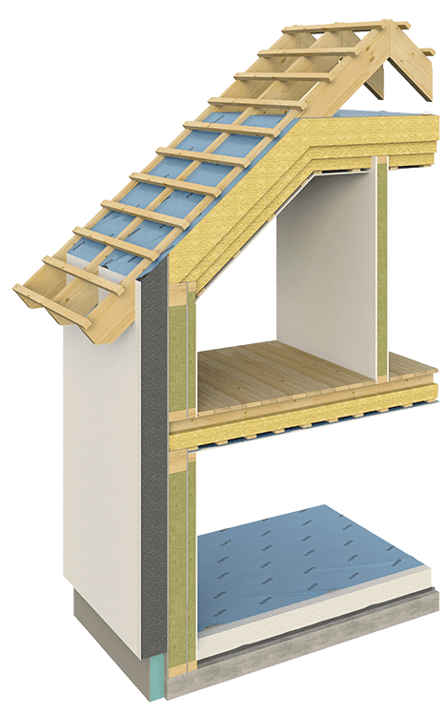
ACTIVITY PROGRESS
O2-T1 Fine-tuning of learning units
LU3: On-site wood construction assembling management
Work planning and team management.
LU4: Functionality and efficiency of wooden buildings
Energy-efficiency value of wood as a building material and wooden constructions.
Climate influence on wooden buildings.
Trainings for plumbing, drywall construction, sealing.
Insight to heating, ventilation, air conditioning, lighting, information and communications technologies systems and its applications in modern buildings.
Workspace organization – ergonomic and labour safety.
Transporting and storing structures on building site.
Architectural design – drawings and schemes.
Building physics, installing of vapour barrier and risks of the resulting condensation.
Fire safety and protection solutions.
Wood based thermal and sound insulation in assembling process.
Compatibility of wood building products (GLT, CLT, EWP etc.) with other construction materials.

Slide 11
PARTNERS
Holzcluster Steiermark
Leading cluster in Graz, developing and implementing projects along the Wood value chains, with special focus on timber construction.
EXELIA
Creative learning solutions company based in Athens, Greece specializing in vocational training with innovative methodologies.
LVT
Prestigious technical education school in Latvia, provides professional education programs, including construction and woodworking.
Universitat Politècnica de València
Public academic institution dedicated to researching and teaching in the field of construction technologies.
Woodpolis
Expert organization providing training and product development services for Wood construction, located in Finland.

Slide 12
CONTACT US: upwood2019@gmail.com
Project coordinator: Austria
Mag. Visnja Koscak
Holzcluster Steiermark GmbH
T +043 (0) 316-58 78 50 - 220
Follow us:
www.upwoodproject.eu
Koscak@holzcluster-steiermark.at
DISCLAIMER: “The European Union support for the production of this publication does not constitute an endorsement of the content which reflects the views only of the authors, and the Commissions cannot be held responsible for any use which may be made of the information held therein.”

