Slide 1
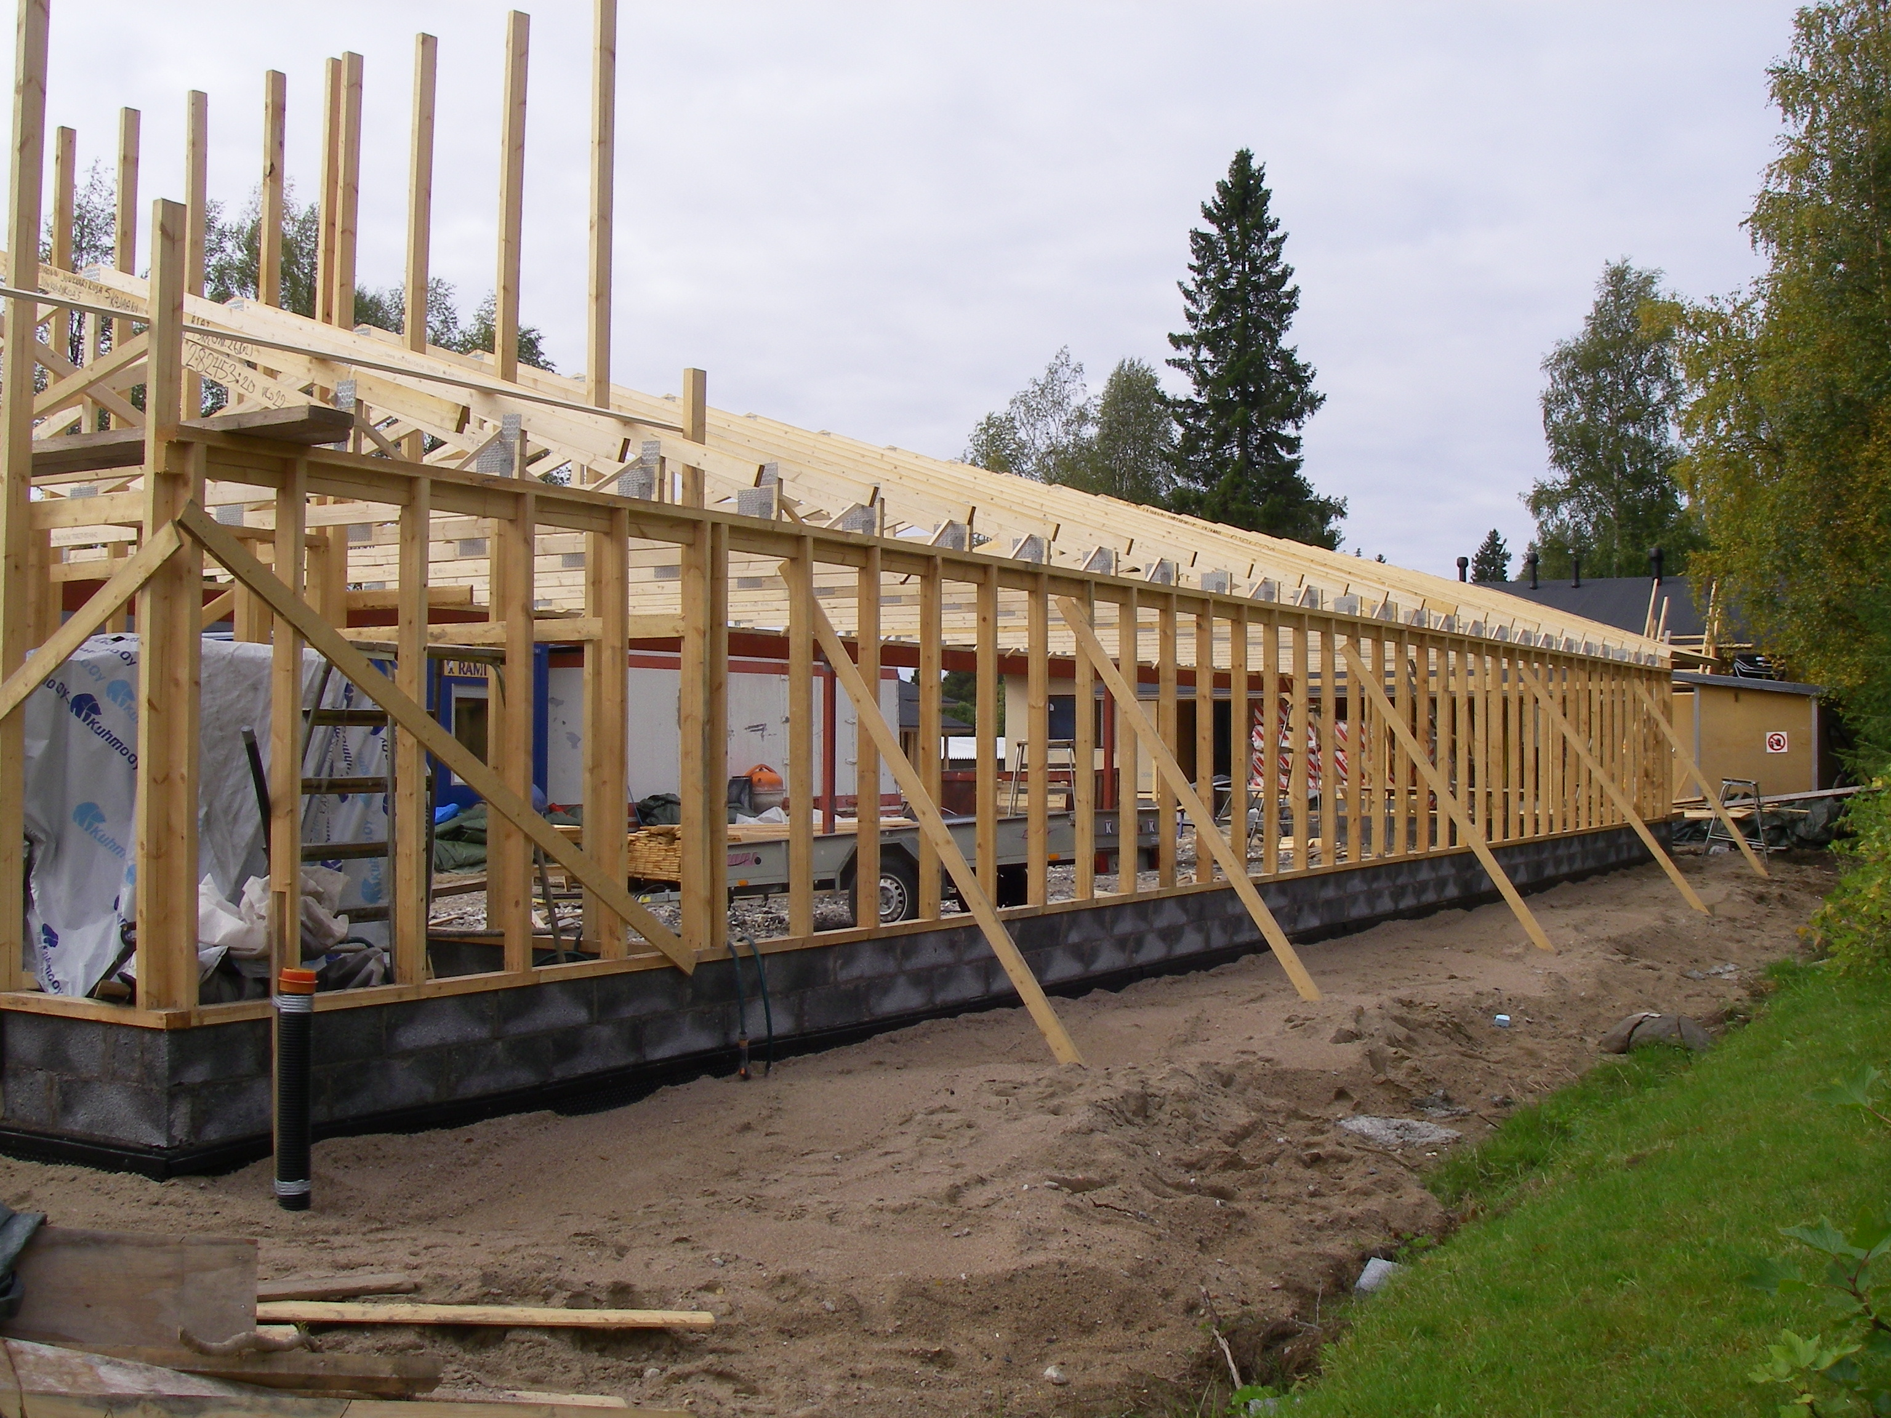
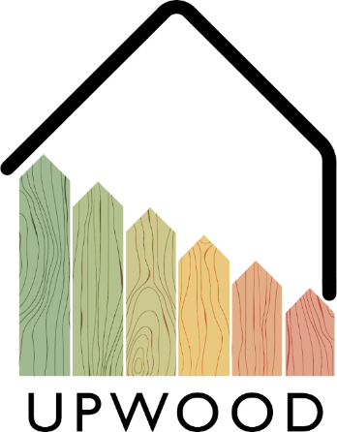
02-6/ LU2: TIMBER CONSTRUCTION, RENOVATION AND RECONSTRUCTION
WOODEN TRUSSES

Slide 2
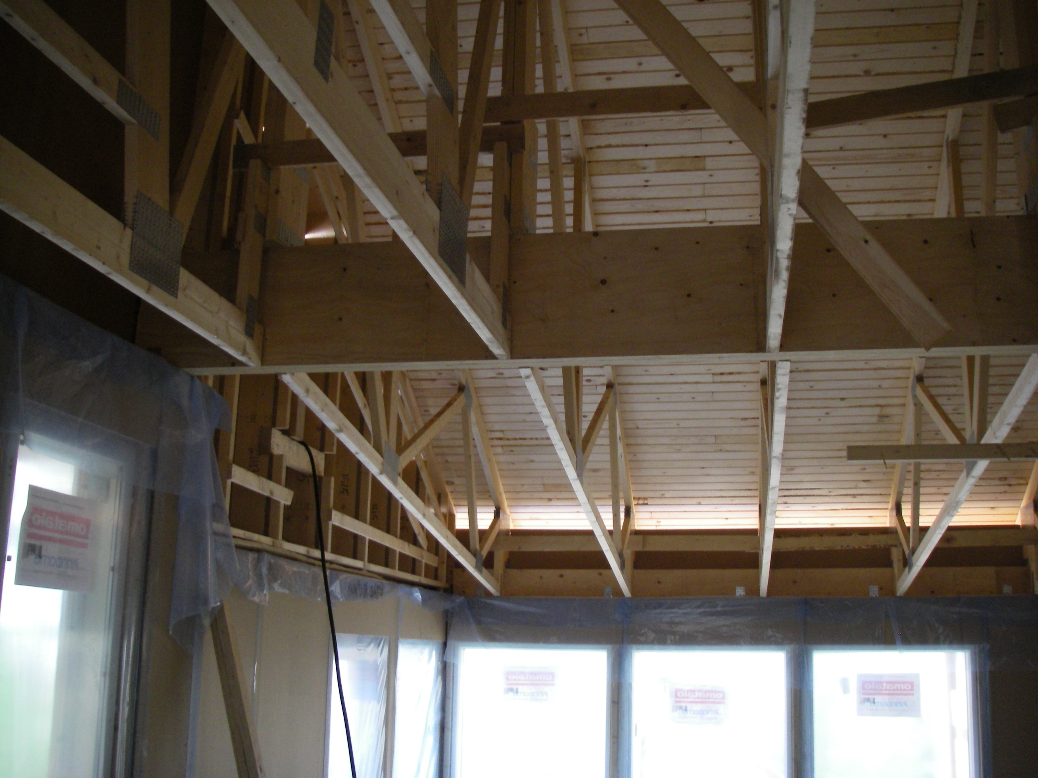
PRESENTATION OVERVIEW
Topics covered
In general
Storage
Installation of truss
Benefits
Frequently asked questions

Slide 3
Roof trusses are used, for example, as a load-bearing upper floor structure for detached houses, terraced and apartment buildings, and warehouse buildings.
Roof trusses are CE marked and manufactured under quality control.
Roof trusses use mechanically dried, planed and strength graded spruce.
The truss delivery usually includes NR structural drawings, strength calculations, and installation and handling instructions for NR structures.
Parts of the roof truss
Brush height
Diagonal rod
Vertical rod
Eaves
Support height
Tie (bottom flange)
In general
3

Slide 4
Wooden roof trusses can be stored on site on a horizontal surface to prevent the formation of permanent deflections.
The nail plate structures are stored in a vertical position bundled and supported by their support points, and care must be taken to prevent the gratings from falling over.
When stored in a horizontal position, the base trees must be sufficiently dense and high (500 mm) and horizontal.
The gratings must be protected from rain, snow, ice and ground contact in the warehouse.
A waterproof cover is used to protect the truss, which must be kept in place even in high winds.
A ventilation gap must be left under the cover to ensure adequate ventilation in the area under protection.
Storage
4

Slide 5
Installation of truss 1/2
Transportation
The grids must be transported in an upright position. If two or more trusses are transported horizontally, the structures must be tied together.
Reception
The delivery of the trusses includes strength calculations as well as a drawing from which it is checked that the requirements presented in it are fulfilled in the structure.
The plans must ensure the following:
Location of support points and minimum width of the support surface
Maximum row spacing
Deflection-supported rods and on-site extensions, e.g., connection of NR structures delivered in two or more parts.
Make sure that the delivery quantity of the trusses corresponds to the order contract.
Storage
The grids can be stored both vertically and horizontally on a flat surface, preferably away from site traffic.

Slide 6
Installation of truss 2/2
Handling
Trusses are designed in a vertical position, so they should be handled and moved in a vertical position.
Lifting
Trusses can be lifted as a bundle over the load-bearing walls from the car or site warehouse. In the case of long trusses, it is advisable to use a lifting beam.
Installation
The installation, fixing and support of the trusses are carried out in accordance with the instructions.
Installation support
The support during installation must be made so that the trusses remain attached to the building and wind load.
Protection
Trusses are protected from getting wet as soon as possible after installation.

Slide 7
Benefits
PRODUCTIVITY
EFFICIENCY
Wooden trusses are strong but lightweight building components that are easy to install and fasten.
With the truss structure, the upper floor can be quickly protected from the weather, even in buildings with long spans.
ENVIRONMENT
COSTS
A lattice made of wood is an ecological building material that can be recycled.
The roof structure made of mechanically sawn wood is strong, yet inexpensive and quick to manufacture.

