Slide 1
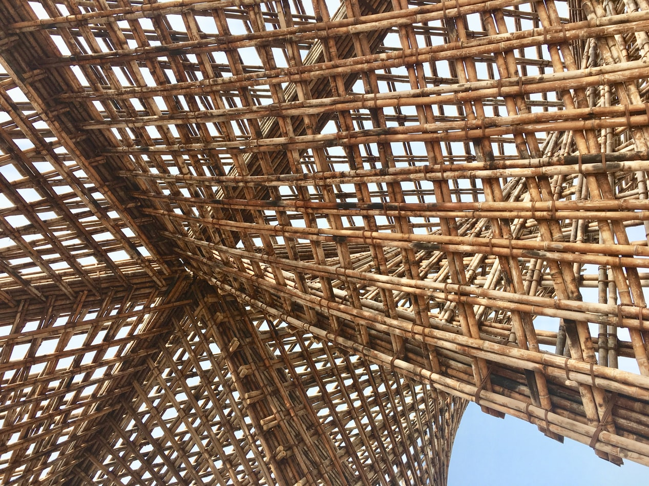

LEARNING UNIT 1:
Lesson 1
Wood properties, its limitations and wood construction physics

Slide 2
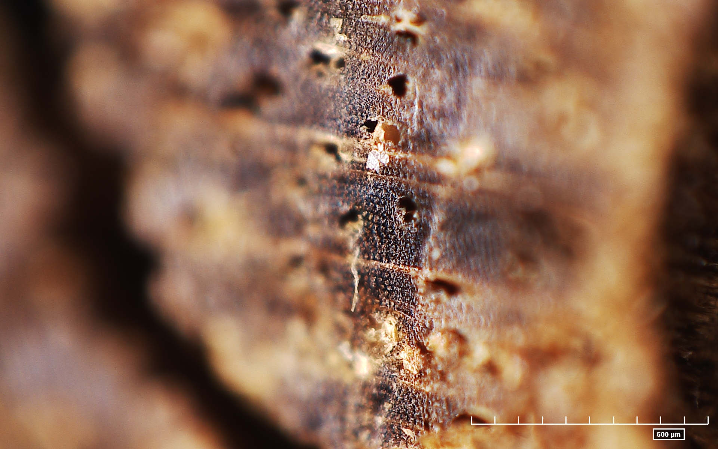
Presentation Overview
TOPICS DISCUSSED
- Wood structure and appearance
- Physical properties
- Mechanical properties
- Technological properties
- Operational properties
LESSON 1: Wood properties, its limitations and wood construction physics

Slide 3
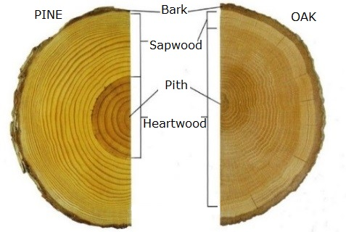
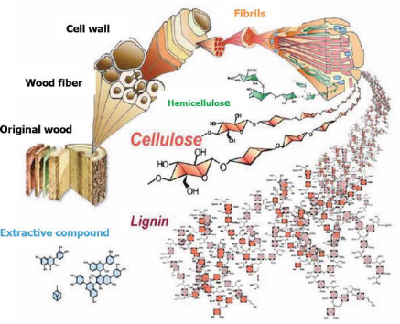
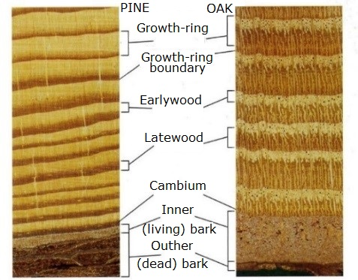
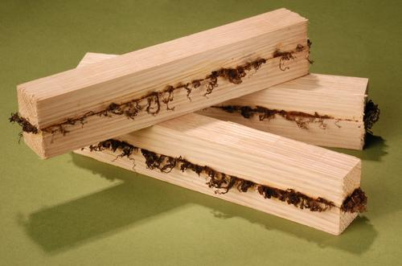
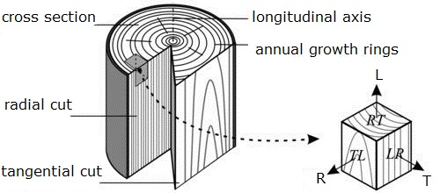
Micro and macro structure
WOOD STRUCTURE AND APPEARANCE
1/2
How it can be used
Wood welding
(click on the picture)
Timber cuts
https://www.twi-global.com/media-and-events/press-releases/2019/twi-develops-wood-welding-process
Theapparat and Chandumpai, Physicochemistry and Utilization of Wood Vinegar from Carbonization of Tropical Biomass Waste. 2018
Hodley R.B. Understanding Wood: A Craftsman's Guide to Wood Technology. 2000
Wertheimer D. Moisture & Wood Movement. How To & Calculators, 2019
3
LESSON 1: Wood properties, its limitations and wood construction physics

Slide 4
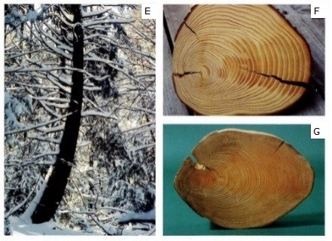
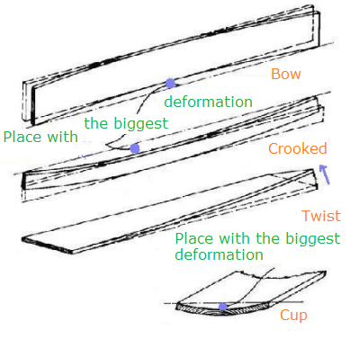
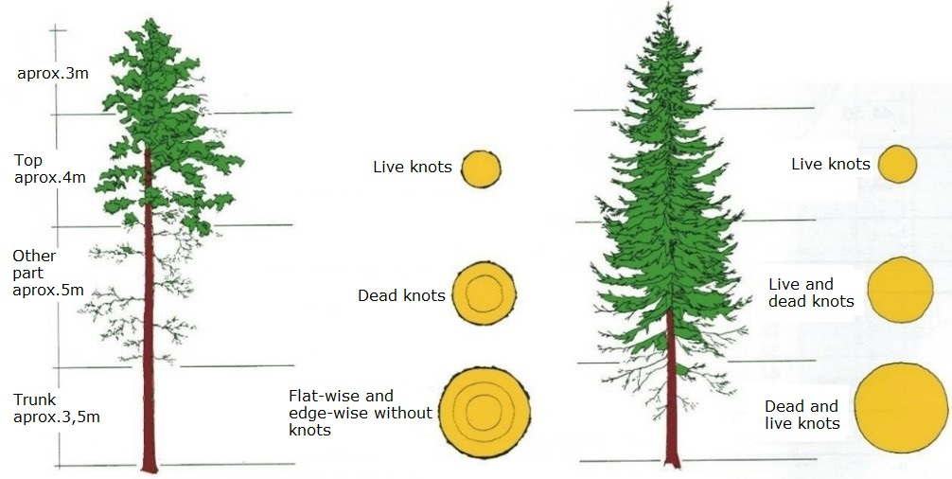
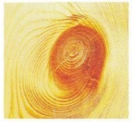


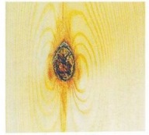
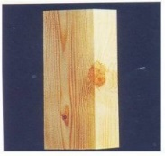
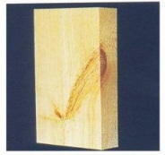

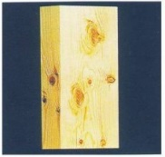
Wood defects and faults
Macroscopic/microscopic
views of reaction wood
Related board defects
WOOD STRUCTURE AND APPEARANCE
2/2
Standing tree (pine and spruce)
Types of knots
live knot | dead knot | knot with bark | rotten knot | edge knot | Wedge knot | leafy knot | group of knots
Hodley R.B. Understanding Wood: A Craftsman's Guide to Wood Technology. 2000
https://20d54786-a-62cb3a1a-s-sites.googlegroups.com/site/leonardoguitarresearch/glossary/Eng%20-%20Deformations.png?attachauth=ANoY7cpapMBSW-3jG8m2jTfvC0iWvOV2qhpRFY_6NjGeyQ5k9rnYg7qjkoj6p7ElcN3HaESI3-yCK9ZVQ-blXo_CeNBUmtt8TG-OSd3CbYG5ygBmqDLpz_3sy2ED1R4tNuMOPe0pjeUr8V82WpbNzWs6q_RP7iJ95pFDwuFXNibm_sE1-hsmLKqeKHr1AtS03ymwZvOPvIA51S0ZBoZNLJkgTklHStCakbNZS18oGgCPxu1uYCffzXRks-zjdcuNxPOtH9r7GCMq&attredirects=0
Wood Handbook, 2010
4
LESSON 1: Wood properties, its limitations and wood construction physics

Slide 5
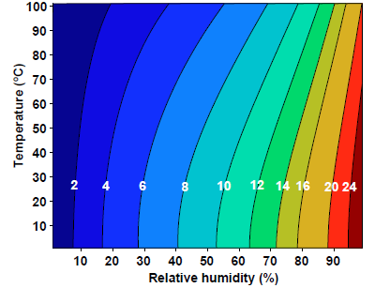
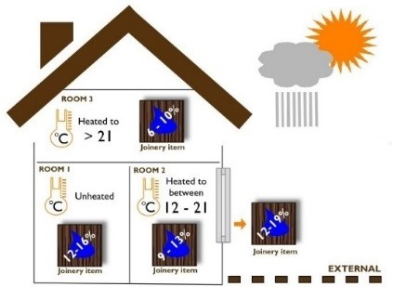
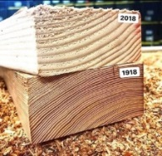
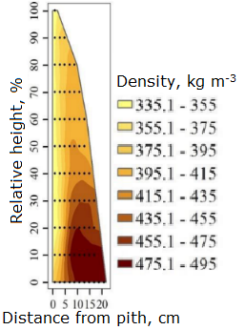
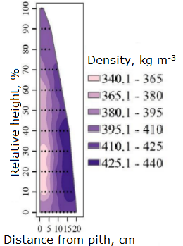
Moisture content (MC) and density
PHYSICAL PROPERTIES
https://www.wooduchoose.com/BlogPost/?Moisture-Content-of-Wood
https://www.reddit.com/r/Damnthatsinteresting/comments/fbhmw1/the_difference_in_density_in_wood_from_1918_to/
Wood Handbook, Robert J. Ross. Forest Products Laboratory USDA Forest Service. 2010, https://www.fs.usda.gov/treesearch/pubs/37440
Liepiņš J. Methodology development for forest stand biomass and carbon stock estimates in Latvia, doctoral thesis, LLU, 2019., 60 p.
5
LESSON 1: Wood properties, its limitations and wood construction physics

Slide 6
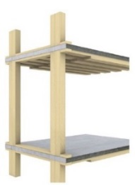
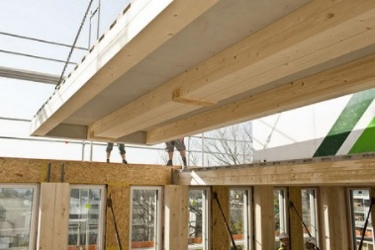
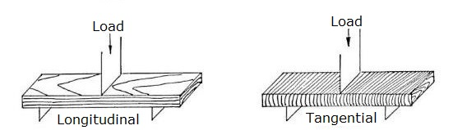
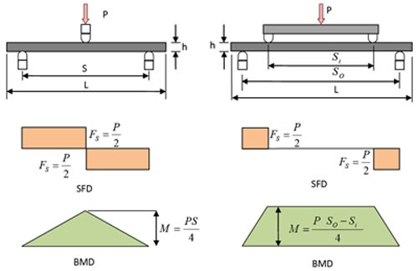
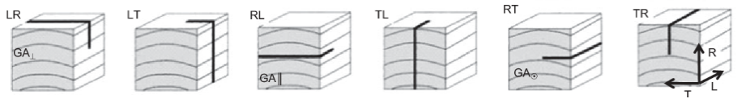
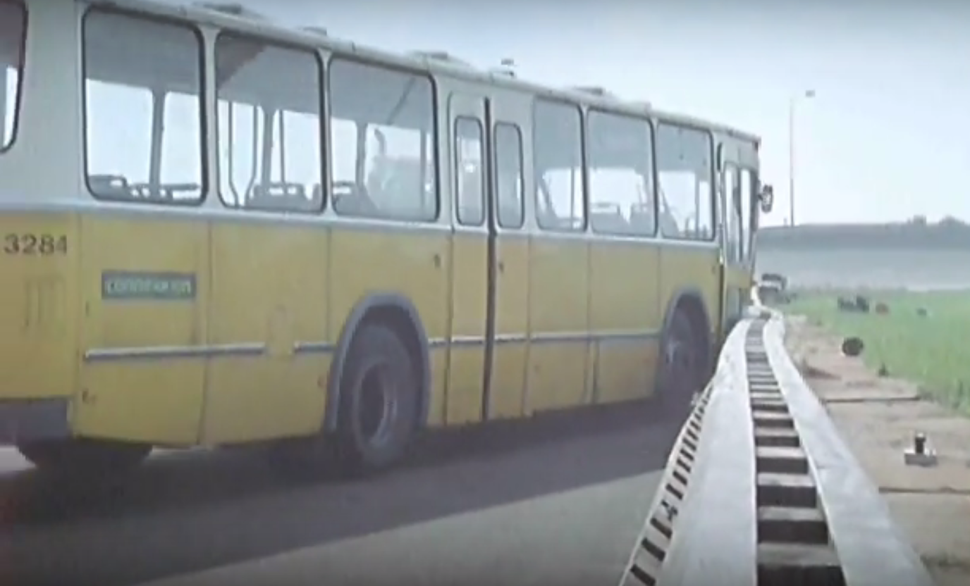
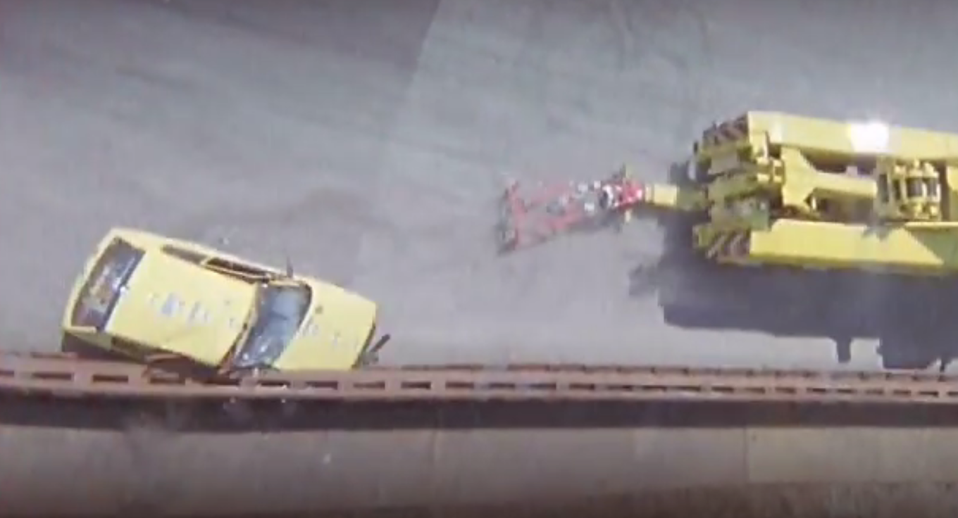



COMPRESSION
MECHANICAL PROPERTIES
$$f_{C}=\frac{F}{a∙b}$$
F- load, N;
a – sample cross section width, mm;
l – sample cross section length, mm.
BENDING
F – max. load, N;
l – span, mm;
b - width of the sample, mm;
h - thickness of the sample, mm;
ΔF - load difference at elastic deformation, N;
Δf - displacement difference at elastic deformation, mm;
TENSION
SHEAR
VISCOELASTICITY (click on the picture)
PROPERTIES OVERVIEW
Wood Species | Bending strength, N mm⁻² |  | Compression strength parallel to grain, N mm⁻² |  | Compression strength perpendicular to grain, N mm⁻² |  | Tension strength parallel to grain, N mm⁻² |  | Density, kg m⁻³
 | MC 12% | MC ≥30% | MC 12% | MC ≥30% | MC 12% | MC ≥30% | MC 12% | MC ≥30%
Pine | 91 | 49 | 50 | 21 | 7,0 | 5,0 | 95 | 78 | 540
Spruce | 87 | 43 | 39 | 19 | 5,3 | 3,8 | 116 | 77 | 470
Oak | 103 | 66 | 57 | 31 | 10,2 | 7,2 | 140 | 107 | 820
https://extension.okstate.edu/fact-sheets/strength-properties-of-wood-for-practical-applications.html
https://www.buildup.eu/en/practices/cases/lifecycle-tower-one-building
https://inhabitat.com/lifecycle-tower-in-austria-will-be-worlds-tallest-wooden-building/new-25-8/
https://nptel.ac.in/content/storage2/courses/101104010/lecture39/39_6.htm
Xu M., Cui Z., Chen Z. and Xiang J. Experimental study on compressive and tensile properties of a bamboo scrimber at elevated temperatures. Construction and Building Materials, Volume 151, 2017
Gupta and Sinha. Effect of grain angle on shear strength of Douglas-fir wood. 2012.
6
6
LESSON 1: Wood properties, its limitations and wood construction physics
LESSON 1: Wood properties, its limitations and wood construction physics

Slide 7
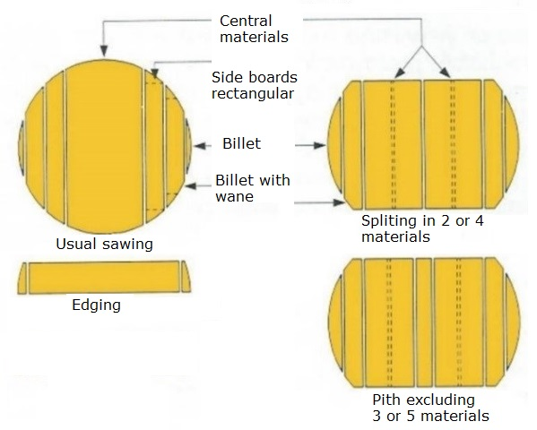
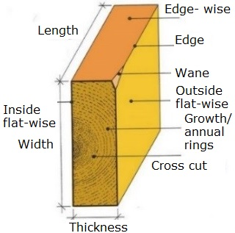
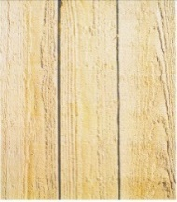
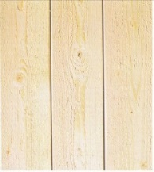
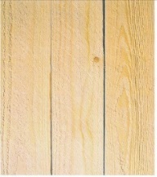
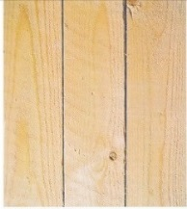
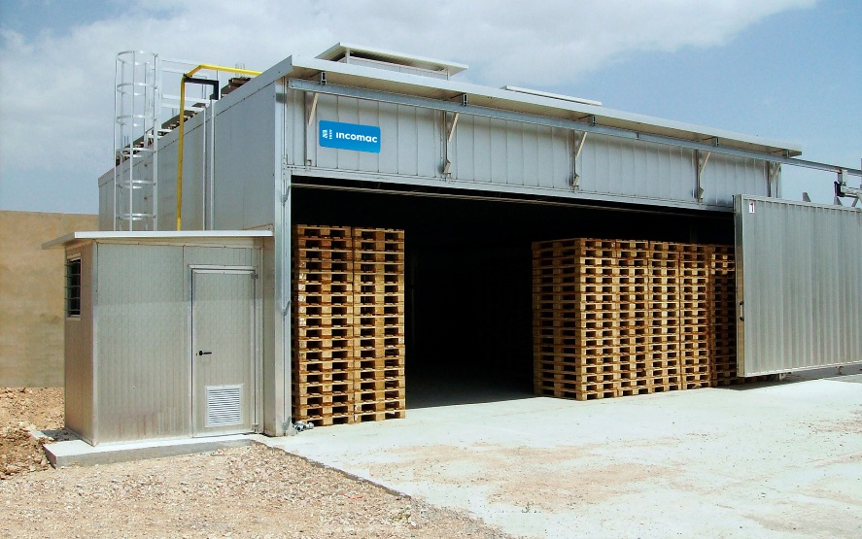
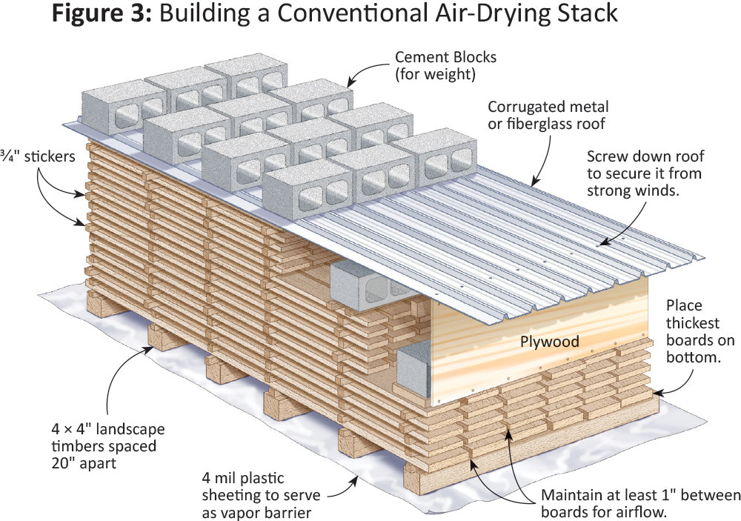
SAWN MATERIALS
TECHNOLOGICAL PROPERTIES
SAWING TYPES
saw-frame sawing | bend-saw sawing | ripsaw sawing | milling machine used
WOOD DRYING
https://www.woodcraft.com/blog_entries/how-to-air-dry-lumber-turn-freshly-cut-stock-into-a-cash-crop-of-woodworking-woods#
https://www.incomac.com/en/prodotti/pal-wood-dryer/
7
LESSON 1: Wood properties, its limitations and wood construction physics

Slide 8
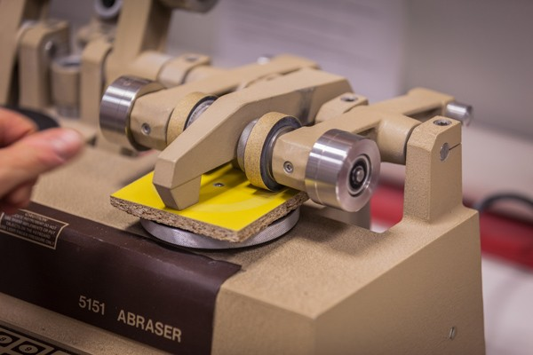
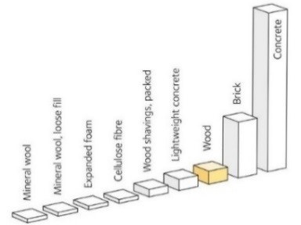

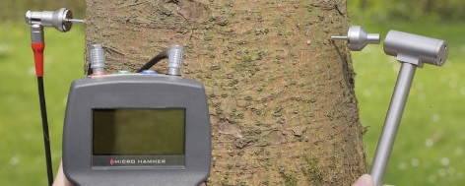
ABRASION RESISTANCE OF WOOD
(click on picture)
OPERATIONAL PROPERTIES
THERMAL CHARACTERISTICS
HARDNESS OF WOOD
Wood Species | Hardness, N mm⁻² | Density, kg m⁻³
 | MC 12%
Pine | 29/14 | 540
Spruce | 26/12 | 470
Oak | 68/40 | 820
SOME WOODEN PRODUCT TESTING
(click on picture)
For example PERGO®
SOUND VELOCITY
(click on picture)
https://catas.com/en-GB/news/the-abrasion-resistance-test
https://www.iml-service.com/sound-velocity-measurement/
https://www.swedishwood.com/wood-facts/about-wood/from-log-to-plank/properties-of-softwood/
https://na.pergo.com/
8
LESSON 1: Wood properties, its limitations and wood construction physics

Slide 9
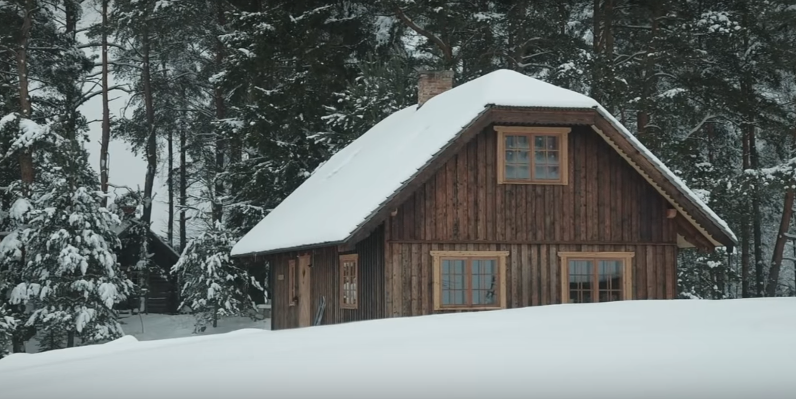
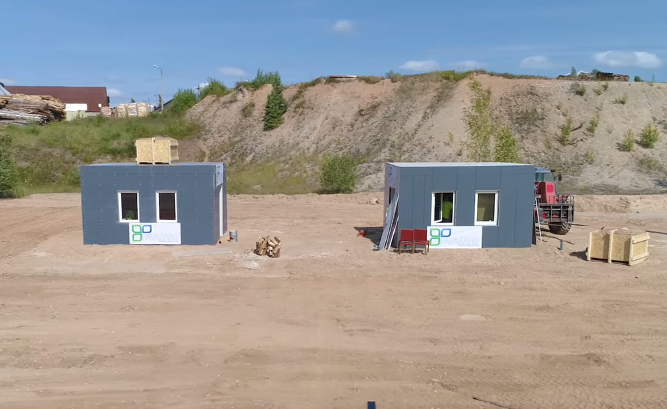
JUST SOME SMART EXAMPLES (click on the pictures)
From AUSTRIA
Limitations:
From GREECE
From FINLAND
Not always, sometimes national laws do not allow to build up multi story houses.
From LATVIA
Sometimes citizens have some prejudices – wooden houses burn, are not sustainable etc.
From SPAIN
In fact, usually we do not have enough knowledge to build up such wooden houses.
LESSON 1: Wood properties, its limitations and wood construction physics

Slide 10
Benefits + or Disadvantages -
ENVIROMNENT and HEALTH +
CIVIL ENGINEERS -
Natural, renewable, CO₂ neutral and recyclable material
Not friendly material for design (properties in all directions are various)
ARCHITECHTS +
COSTS -
Presentations are communication tools that can be demonstrations, lectures, speeches, reports, and more.
Not always the cheapest building material compete with structural steel or concrete
LESSON 1: Wood properties, its limitations and wood construction physics

Slide 11
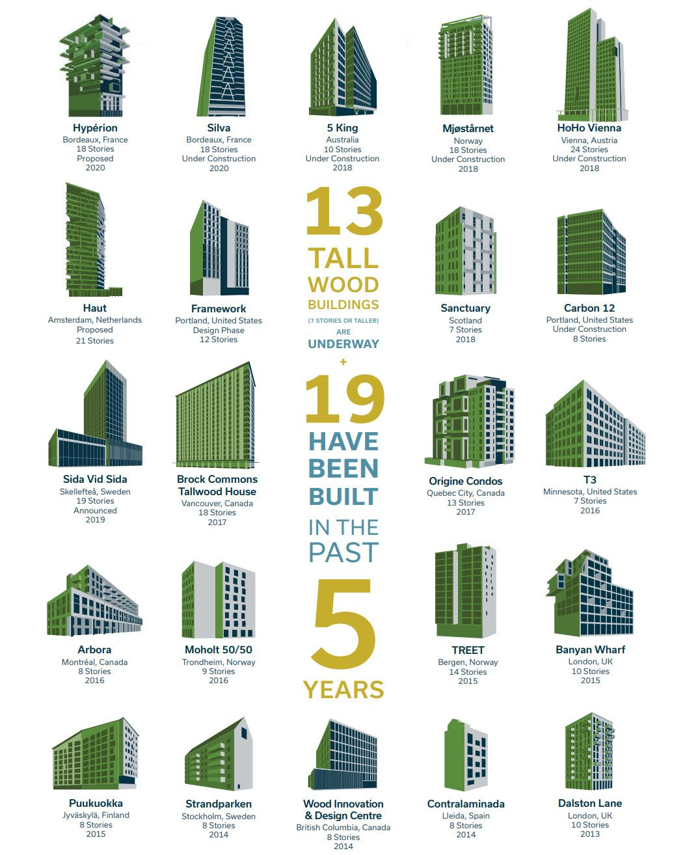
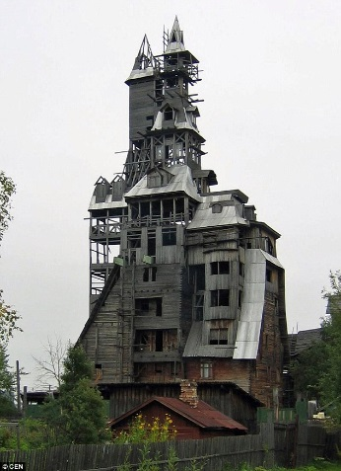
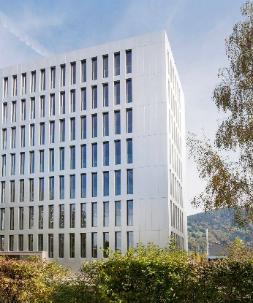

Future vision
(click on following buildings)
PAST
NOWADAYS
FUTURE
https://www.creebuildings.com/project/life-cycle-tower-one
https://www.thinkwood.com
11
LESSON 1: Wood properties, its limitations and wood construction physics

Slide 12
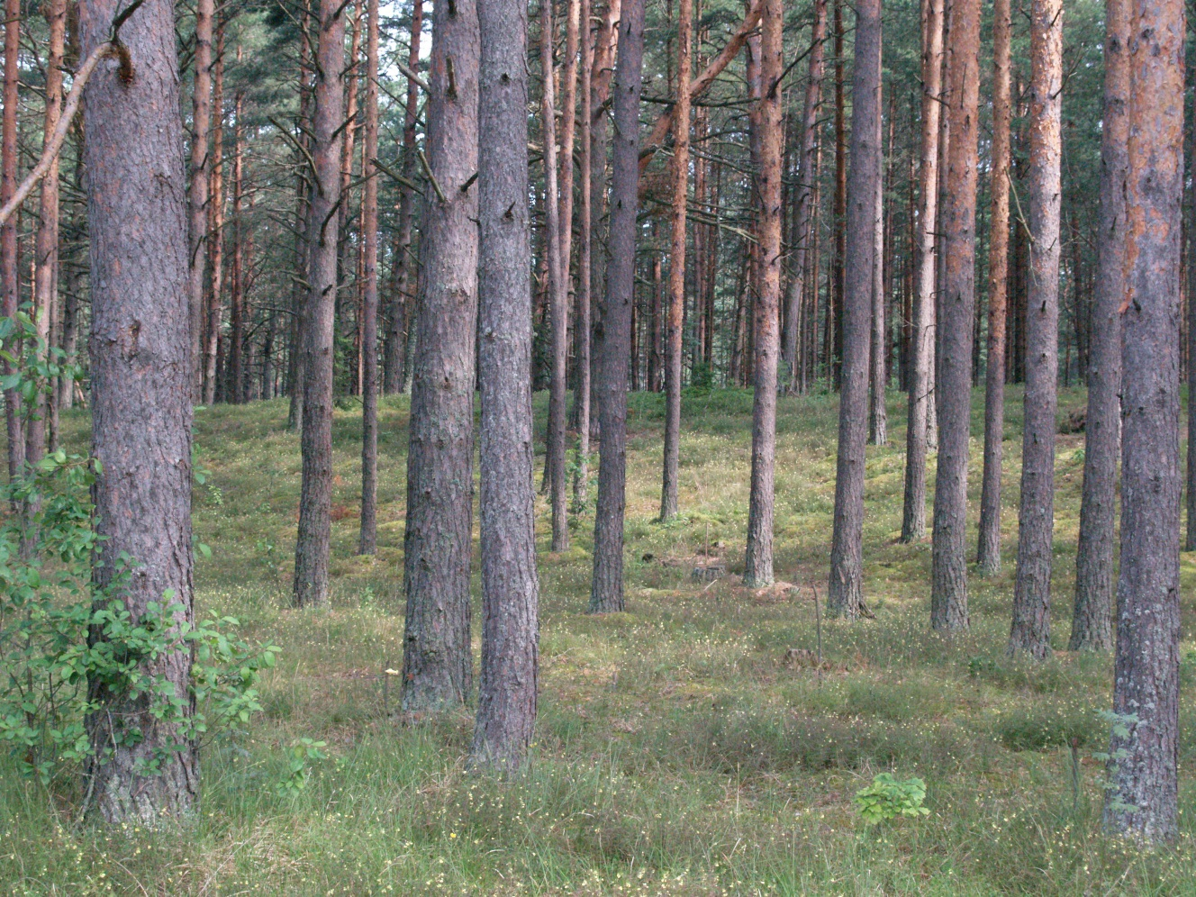
  1. What are the main sections of the pine trunk?
A: lower trunk part without knots; middle trunk part with dead knots; upper trunk part with live knots
2. What components of the trunk are visible in its cross section (mention at least 3 of them?
A: bark; pith; sapwood; heartwood; growth-annual rings; early wood; late wood
  3. What chemical elements are in wood?
A: carbon (C), hydrogen (H), oxygen (O) and nitrogen (N)
  4. What is wood moisture content (MC)?
A: It is water content in the wood, calculated in percentage
  5. What kind methods of determination of the wood moisture content (MC) do You know?
A: Electric moisture method; oven dry method; hygrometric method and distillation method
  6. What is wood shrinkage and swelling in which direction is the greatest one?
A: Changes of dimensions, in tangential
  7. What is the density of wood, units? Why determine the standard density at ρ₁₂?
A: It is mass of wood peace divided by its volume, kg m⁻³. Just to compare the density between wood species
  8. What is the strength of the wood?
A: Maximum force which can be applied to the exact material
  9. In which direction is the strength greater?
A: In direction of wood fiber (parallel to fiber direction)
  10. What types of branches can be found on sawn timber surface?
A: live knot; dead knot; knot with bark; rotten knot; edge knot; wedge knot; leafy knot; group of knots
  11. How do the knots affect the strength and quality of wood?
A: Group of knots decrease strength of knots
  12. What are the timber defects for standing tree?
A: juvenile wood, reaction wood and slope of grain
QUESTIONS AND ANSWERS
12
LESSON 1: Wood properties, its limitations and wood construction physics

Slide 13
EN 13183-1:2002 Moisture content of a piece of sawn timber. Determination by oven dry method.
EN 13183-2:2002 Moisture content of a piece of sawn timber. Estimation by electrical resistance method.
EN 13183-3:2005 Moisture content of a piece of sawn timber. Estimation by capacitance method.
Gupta and Sinha. Effect of grain angle on shear strength of Douglas-fir wood. 2012., DOI:10.1515/hf-2011-0031Hoadley R.B. Understanding wood. The Taunton Press, China, 2000., 280 p.
Hodley R.B. Understanding Wood: A Craftsman's Guide to Wood Technology. The Taunton Press; 1st edition, 2000., 288 p.
Liepiņš J. Methodology development for forest stand biomass and carbon stock estimates in Latvia, doctoral thesis, LLU, 2019., 60 p.
Softwood sawn material application. Guidelines. (Skujkoku zāģmateriālu pielietošana. Vadlīnijas. In Latvian). 2009., ISBN/ISMN 978-9984-39-720-7.
Theapparat Y., Chandumpai A. and Faroongsarng D. Physicochemistry and Utilization of Wood Vinegar from Carbonization of Tropical Biomass Waste. DOI: 10.5772/intechopen.77380
Wertheimer D. Moisture & Wood Movement. How To & Calculators, 2019., https://www.branchingoutwood.com/blog/wood-movement-and-moisture.
Wood Handbook, Robert J. Ross. Forest Products Laboratory USDA Forest Service. 2010, https://www.fs.usda.gov/treesearch/pubs/37440
Xu M., Cui Z., Chen Z. and Xiang J. Experimental study on compressive and tensile properties of a bamboo scrimber at elevated temperatures. Construction and Building Materials, Volume 151, 2017, pp. 732-741.
References
JOURNALS AND PUBLICATIONS
13
LESSON 1: Wood properties, its limitations and wood construction physics

