Slide 1
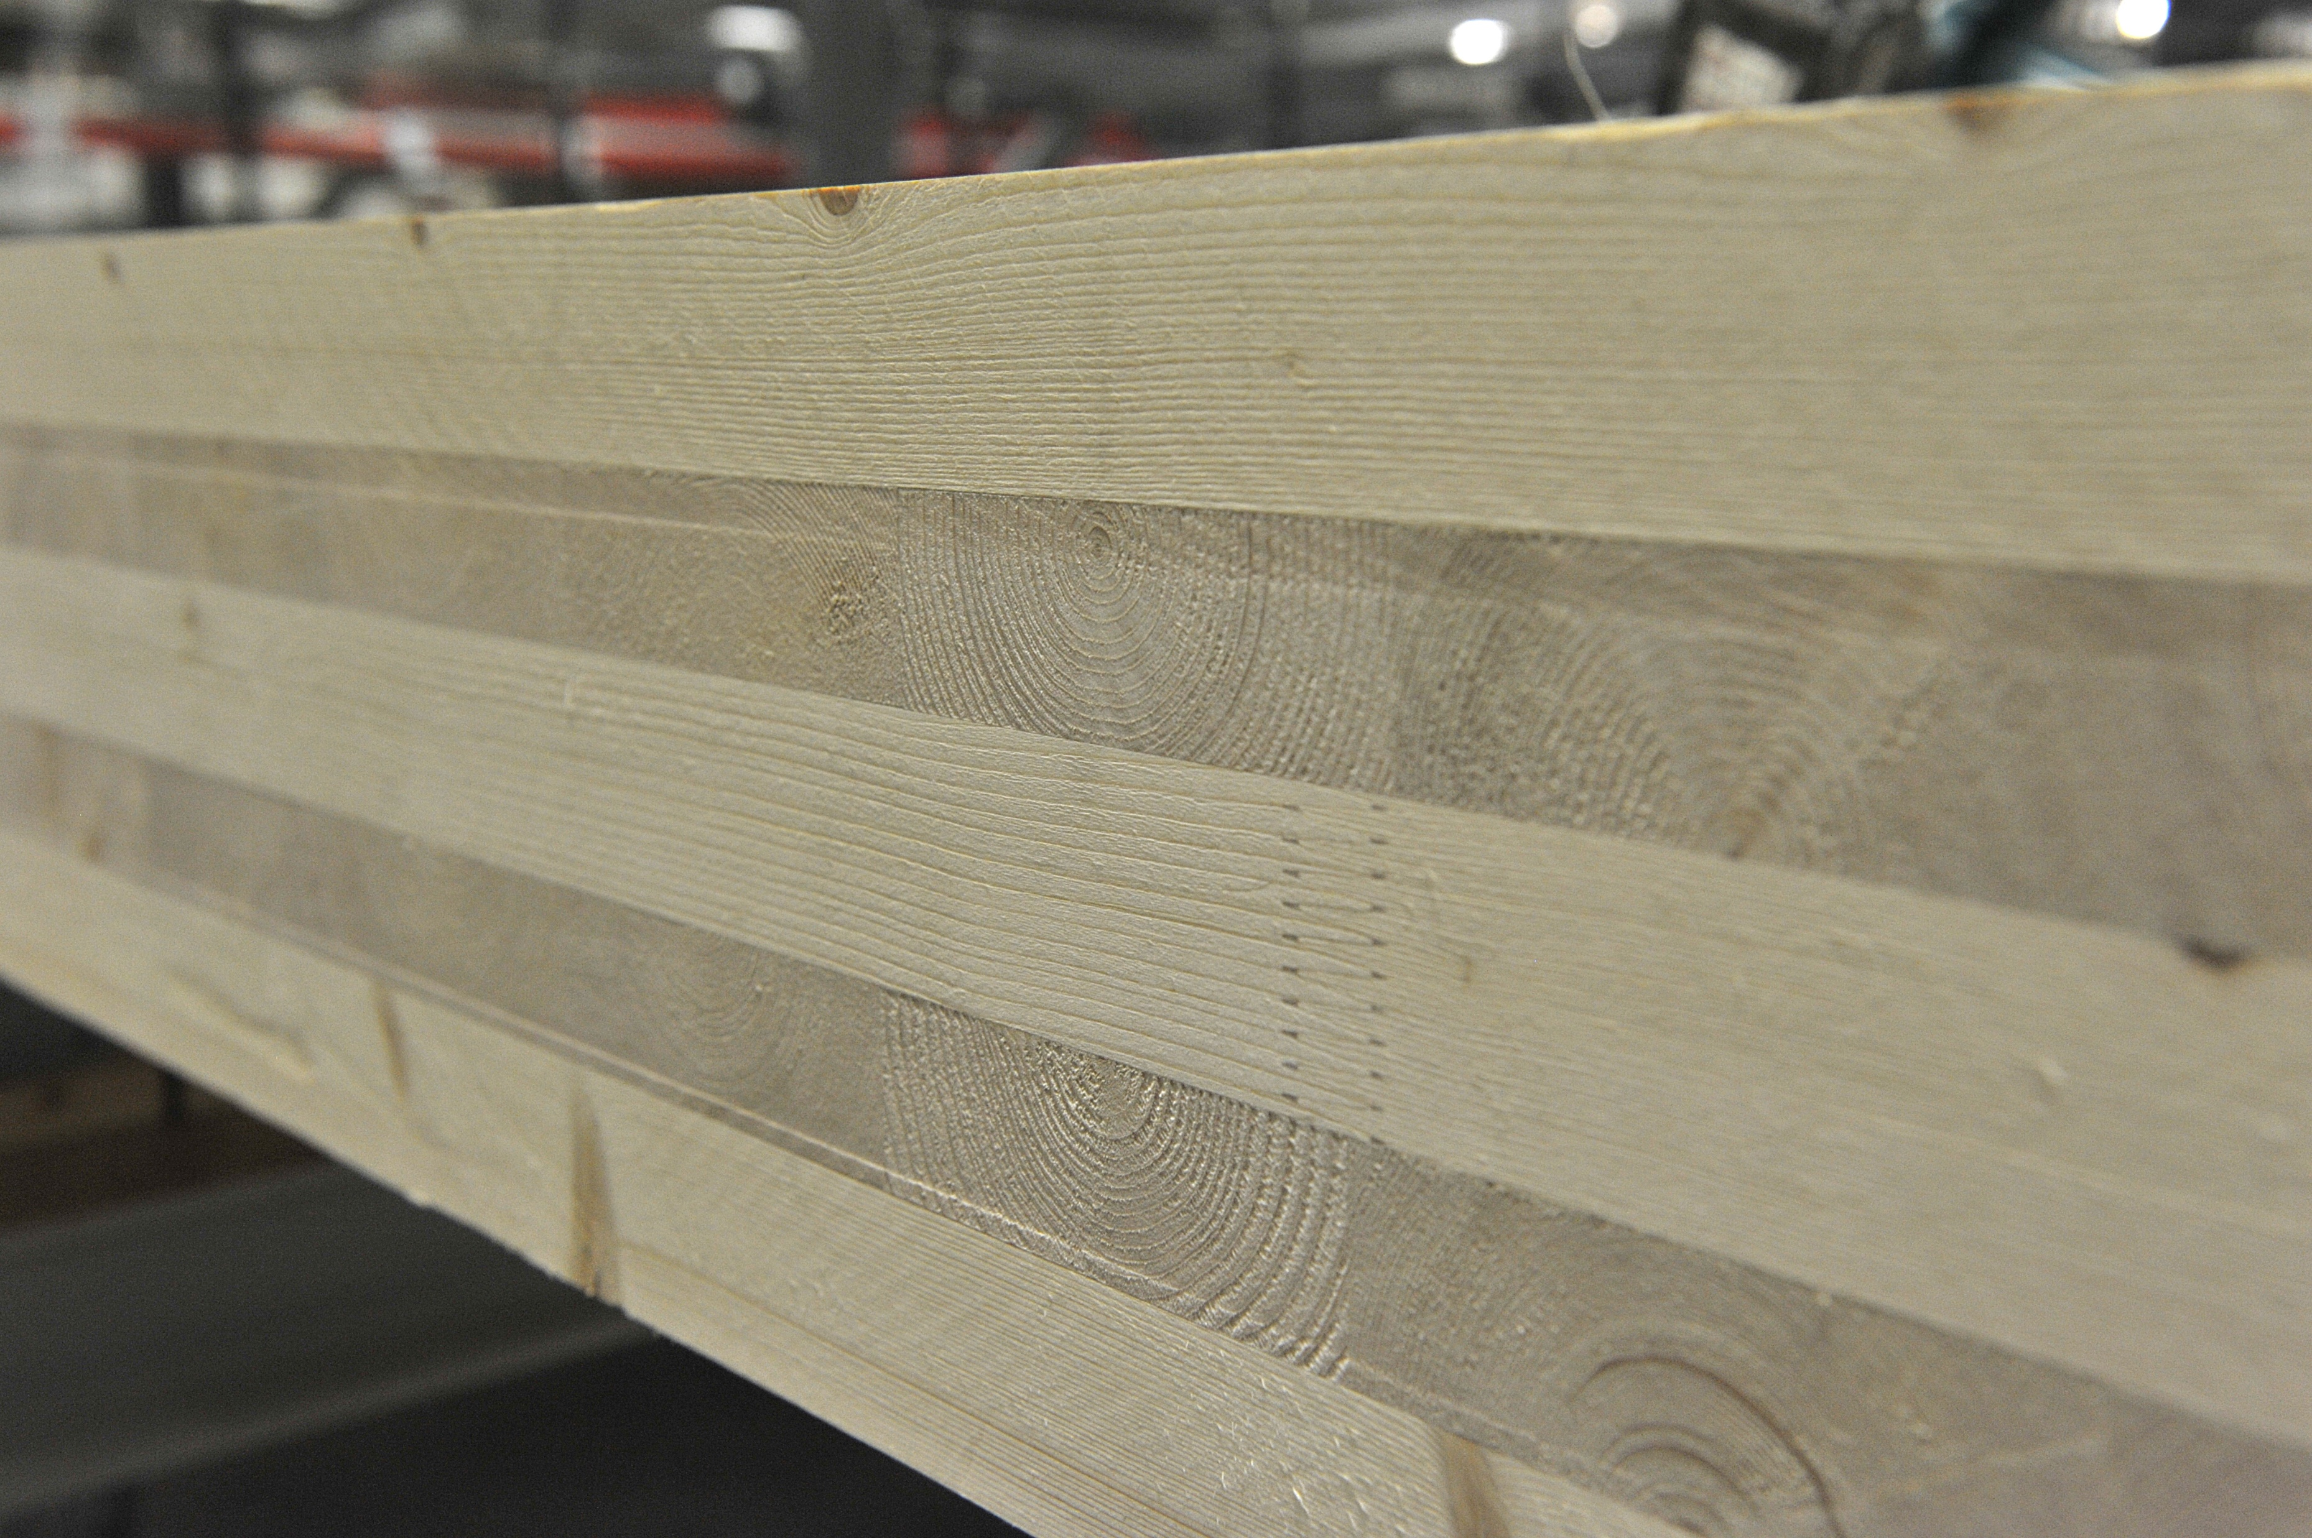
03-3/ LU2: TIMBER CONSTRUCTION, RENOVATION AND DECONSTRUCTION
GUIDELINES ON WORK WITH GLT AND CLT

Slide 2
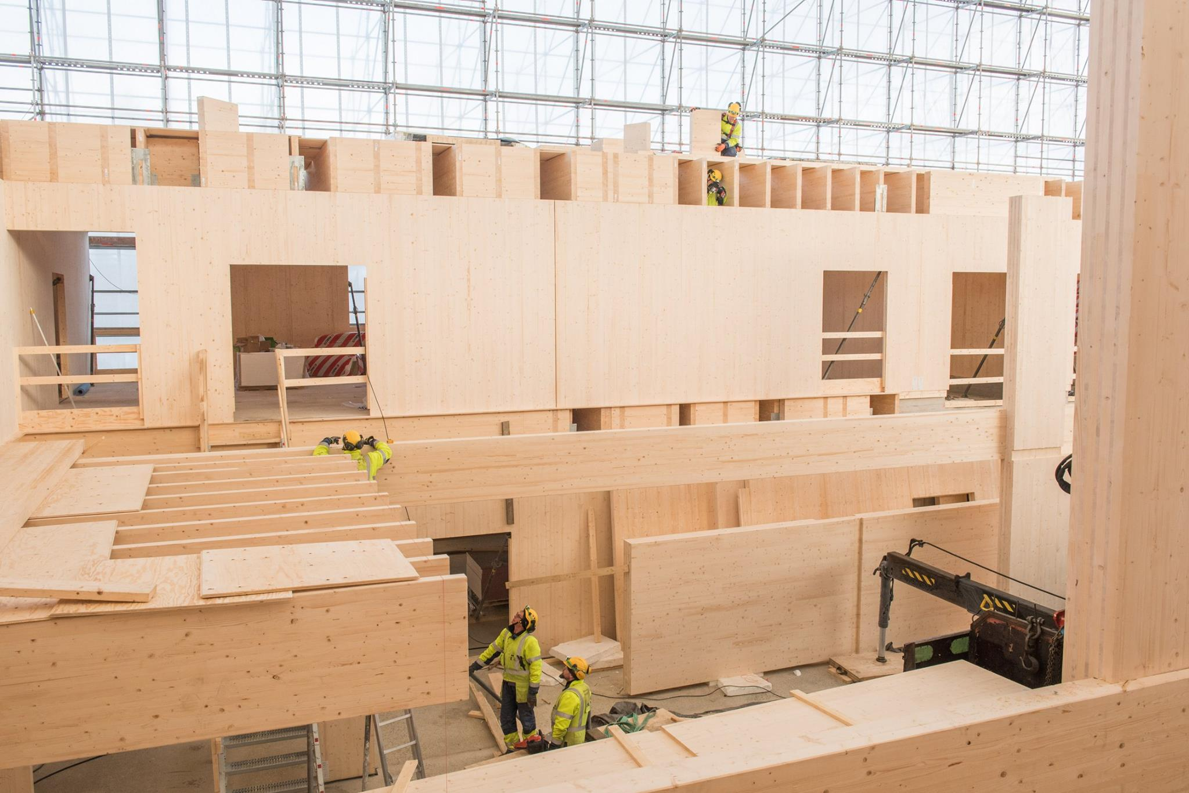
PRESENTATION OVERVIEW
Topics covered
- GLT
CLT
Using GLT and CLT products
Installation
Frequently asked questions

Slide 3
GLT or Glulam in general, means a wood product made by gluing lamellas, consisting of at least two 45 mm thick, planed sawn timber where the grain direction is longitudinal to the product.
Glulam beams have a good fire resistance and do not bend under the influence of heat like iron beams. The carbonization rate of the glulam is about 0.6 mm per minute and the steel parts embedded in the glulam are also fire-protected for a corresponding period.
Glulam is used e.g., in industrial and sports halls, supermarkets, exhibition halls and schools, but also in log blanks, detached houses and barns.
GLT
(Glue Laminated Timber)
3

Slide 4
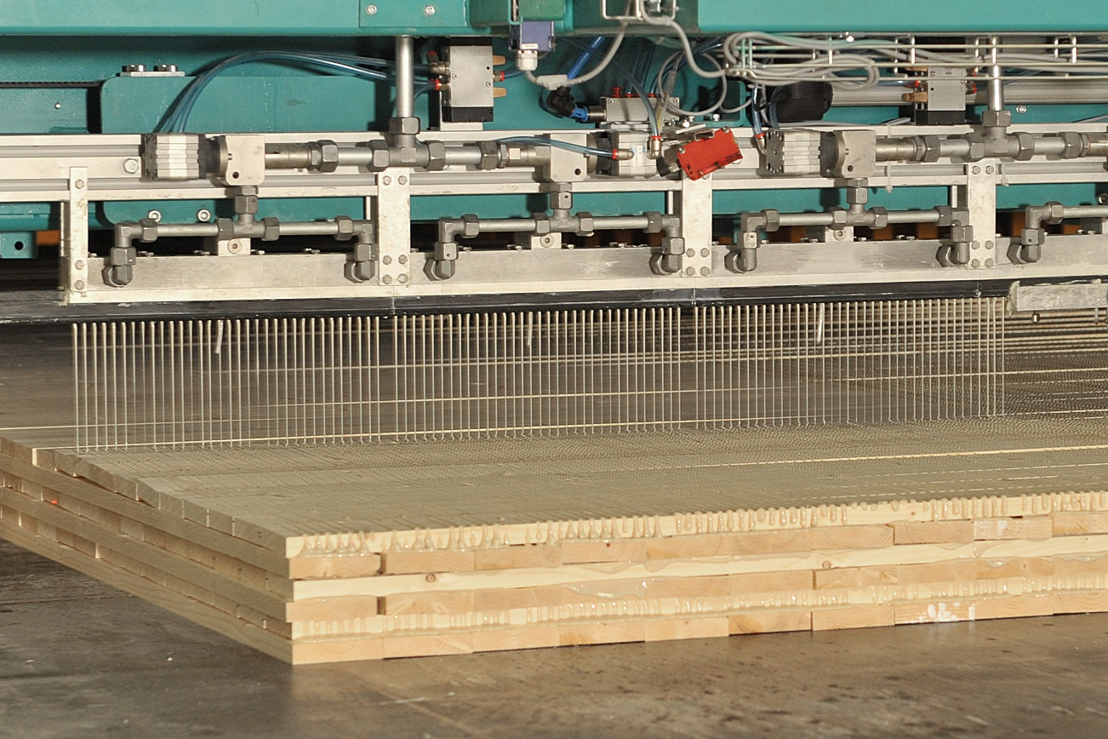
The CLT consists of three or five layers of cross-glued boards. The boards are strength graded and finger extended. It forms a very fire-resistant, very strong and rigid but lightweight building board.
The raw material is spruce or pine, but other types of wood can also be used on visible surfaces.
CLT-levyn valmistustekniikkoja on useita.
In a side-glued board, the board layers are first glued into glue boards and only then the overlapping planes are glued cross-stacked.
Side gluing can be omitted, in which case the boards are stacked crosswise, and the glue is applied in layers.
The gluing method chosen affects the properties of the board.
CLT
(Cross Laminated Timber)
4

Slide 5
Using GLT and CLT products
PRODUCTIVITY
EFFICIENCY
CLT and GLT are ideally suited for a variety of construction technologies. Machining into wood is fast and does not require special technology.
Solid wood is heat-storing and moisture-balancing, it is a familiar and safe, ecological and domestic material.
ENVIRONMENT
COSTS
Wood as a material binds carbon, so the wood product in the structure acts as a carbon store. Wood is a renewable material.
The plate brings dimensional accuracy to the structure, so the installation of plates or space elements made of plates is quick because no separate stiffeners or collars are required.

Slide 6
Installation
For the installation plan of the elements, the structural designer shall provide sufficient information on safe lifting, handling, installation levels during work, installation sequence, temporary support and final fastening.
A written installation plan for the installation work will be prepared for the site, which will be signed by the main structural designer, the Installation Supervisor and the corresponding master of the main contractor.
The installation plan takes into account e.g., temporary storage of elements, lifting aids, connection materials, connection methods, protection of elements, support during installation of elements, minimum support surfaces and installation sequence.
Any changes will be approved by the responsible structural designer before work begins, and the elements must be lifted and installed in accordance with the installation plan and the element manufacturer's instructions.
6

